Slide 1

Introduction to PIC Microcontrollers
DAY 21
EMBEDDED SYSTEM DESIGN & IoT-Master Class

Slide 2
What You will learn Today?
Introduction to PIC
Families of PIC
Pin Details and Descriptions
Peripherals in PIC
Compilers
Registers

Slide 3
Mindset Lesson for the Day
Life is a mirror ,You see what you are.
You Attract what you think all day long.

Slide 4
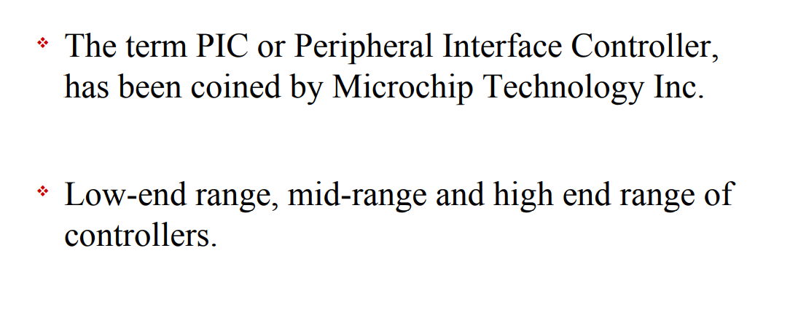
What is PIC

Slide 5
PIC
It has a smaller 35 instructions set.
It can operate up to 20MHz frequency.
The operating voltage is between 4.2 volts to 5.5 volts. If you provide it voltage more than 5.5 volts, it may get damaged permanently.
It does not have an internal oscillator like other PIC18F46K22, PIC18F4550.
The maximum current each PORT can sink or source is around 100mA. Therefore, the current limit for each GPIO pin of PIC16F877A is 10 mili ampere.
It is available in four IC packaging such as 40-pin PDIP 44-pin PLCC, 44-pin TQFP, 44-pin QFN
It has a total number of 40 pins and there are 33 pins for input and output.

Slide 6
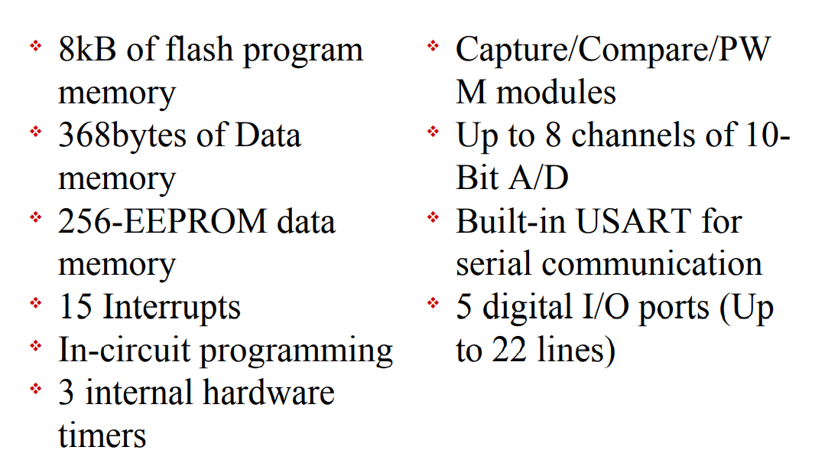
Features

Slide 7
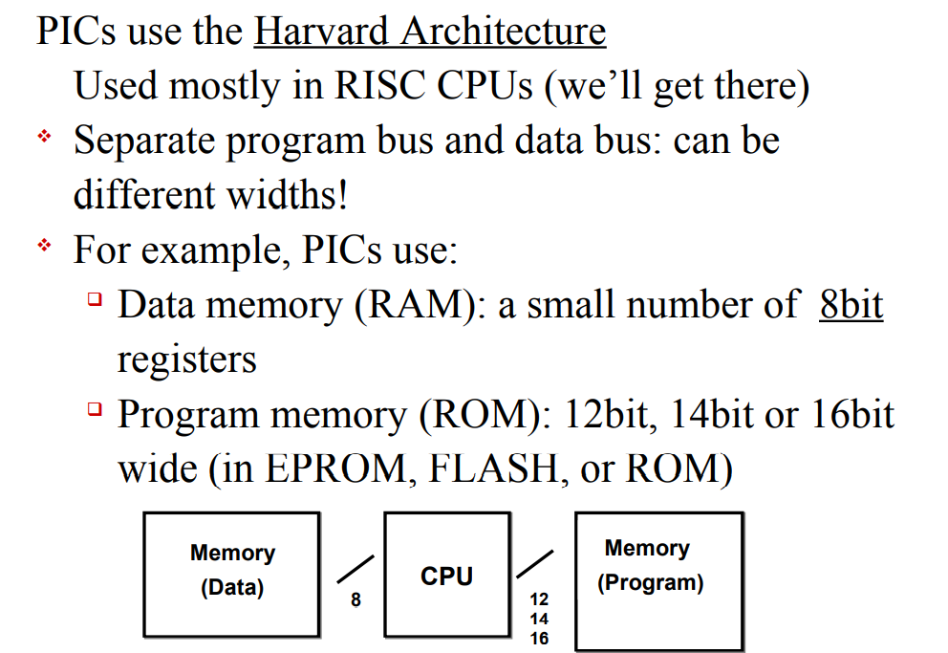
PIC Architecture: Background

Slide 8
PIC Family
Features | Baseline | Mid-Range | Enhanced Mid-Range | Advanced PIC18
Families | PIC10, PIC12, PIC16 | PIC10, PIC12 | PIC12Fxxx,PIC16Fxxx | PIC 18
Program Memory | Max 3 KB | Max 14 KB | Max 28 KB | Max 128 KB
Data Memory | Max 138 Bytes | Max 368 Bytes | Max 1-5 KB | Max 4 KB
Performance | 5 MIPS | 5 MIPS | 8 MIPS | 16 MIPS
Features | 8-bit ADC | Addition to baseline | Addition to midrange | CAN
 | Internal Oscillator | I2C/SPI | Multiple Peripheral communication | USB
 | Comparator | PWM | High Performance | ETHERNET
 |  | UART | PWM with independent Time-Space | LIN
 |  | 10-bit ADC |  | PLL Clock generatION
PIC18FXXX – ‘F’ implies Flash Program Memory
PIC16CXXX – ‘C’ implies EPROM Program Memory
PIC18LFXXX – ‘LF” implies Low Voltage operation

Slide 9
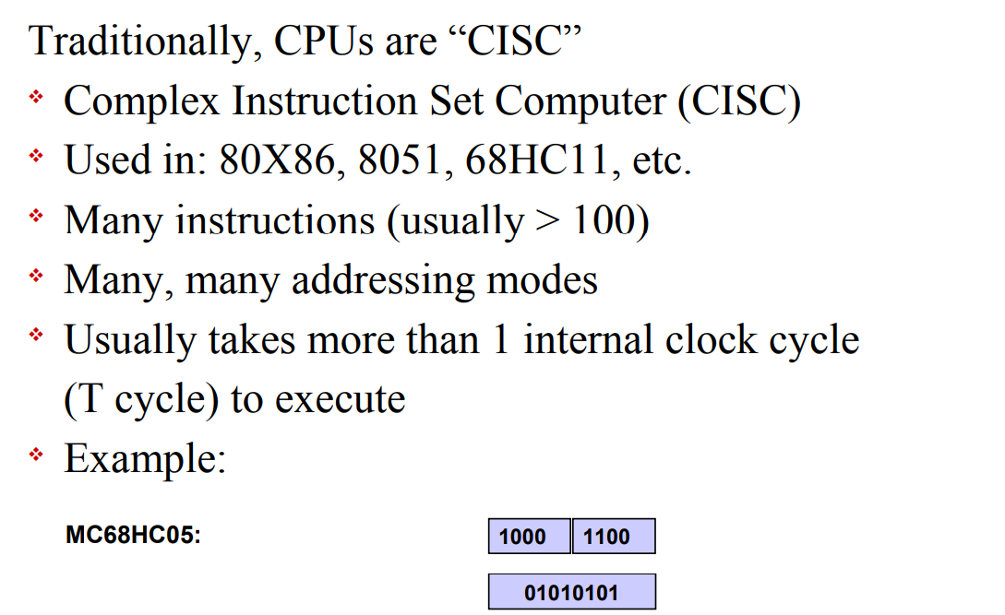
CISC

Slide 10
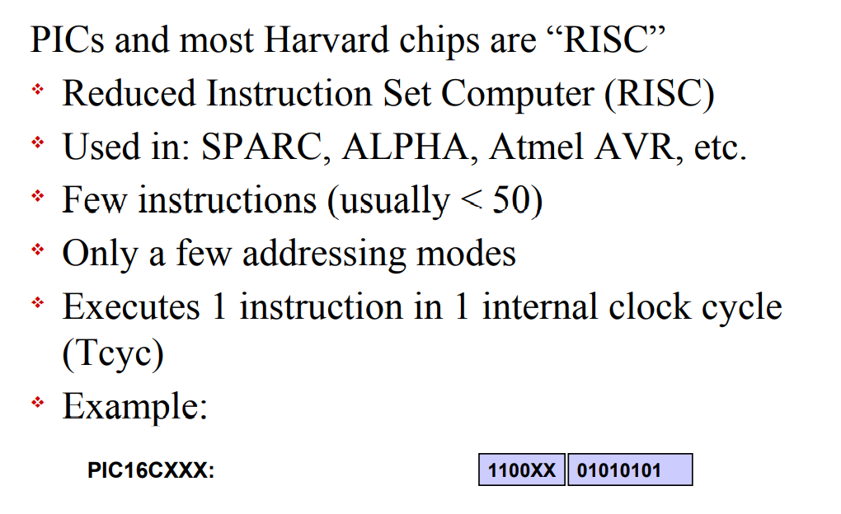
RISC

Slide 11
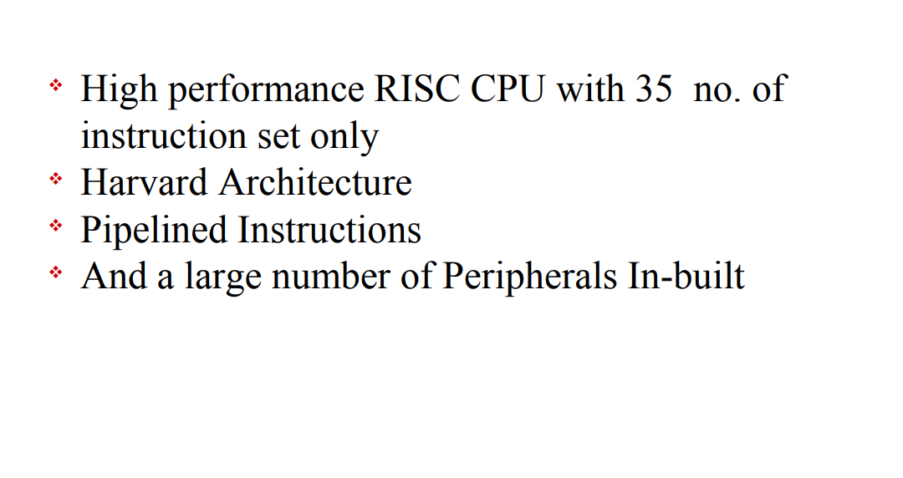
What is different in PIC

Slide 12
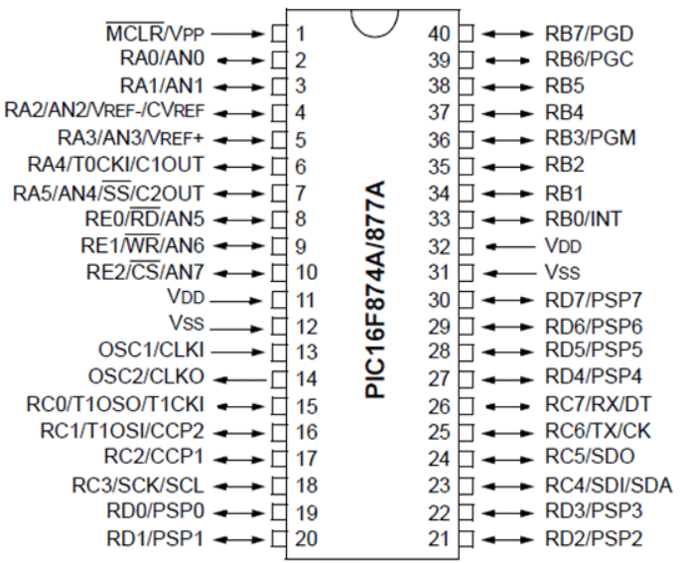
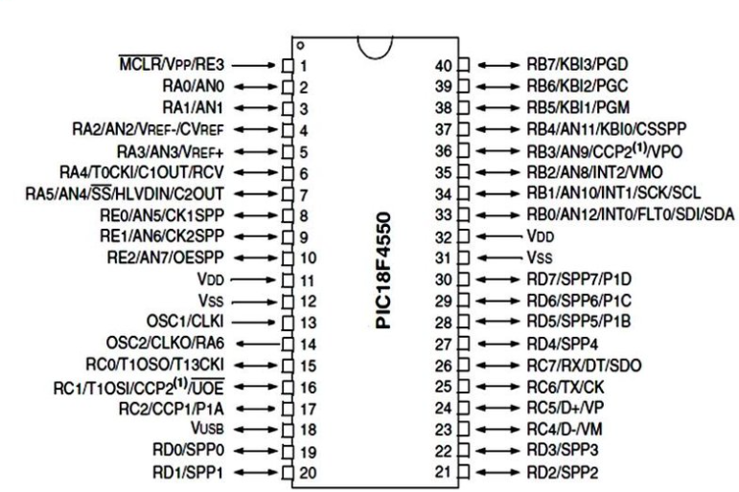
PIC PIN Diagram

Slide 13
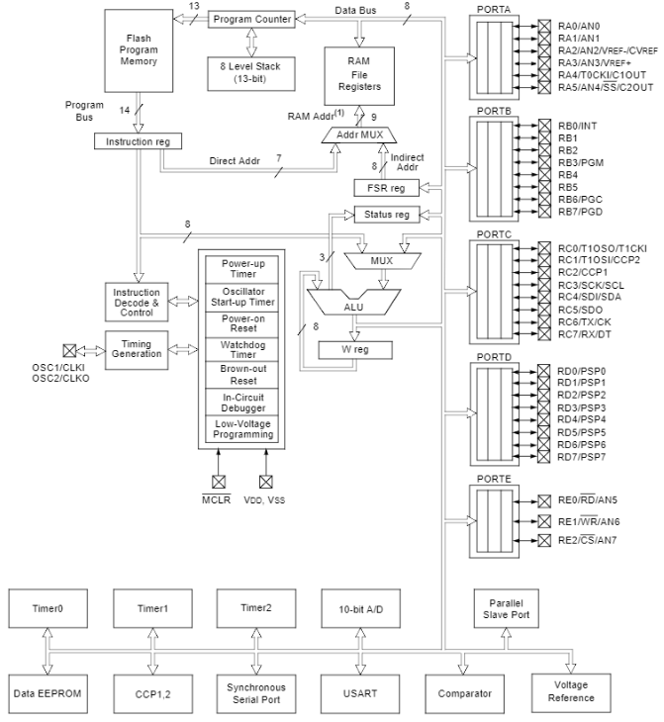
Block Diagram-Refer PIC16F877A Datasheet-Page 7

Slide 14
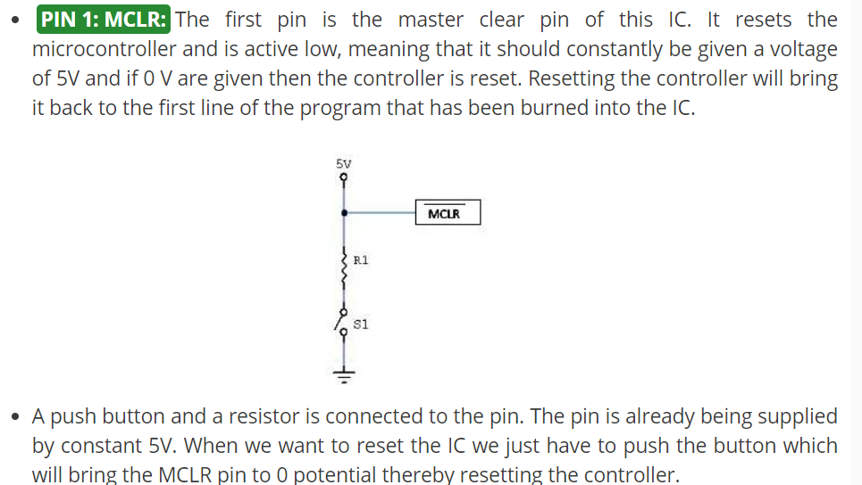
MCLR –Master Clear

Slide 15
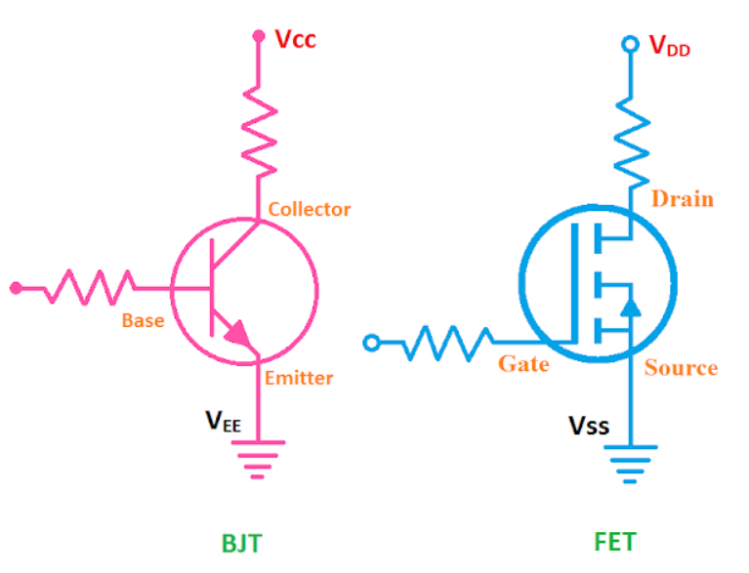
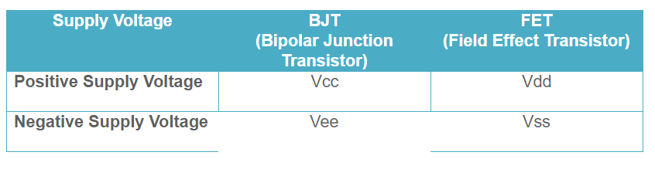
What is VDD,VCC ,VSS,VEE

Slide 16
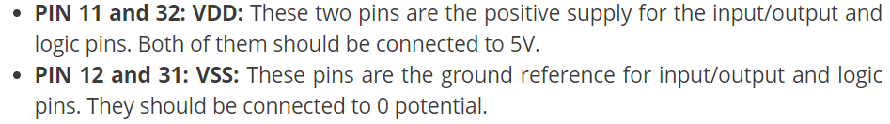
VDD and VSS

Slide 17
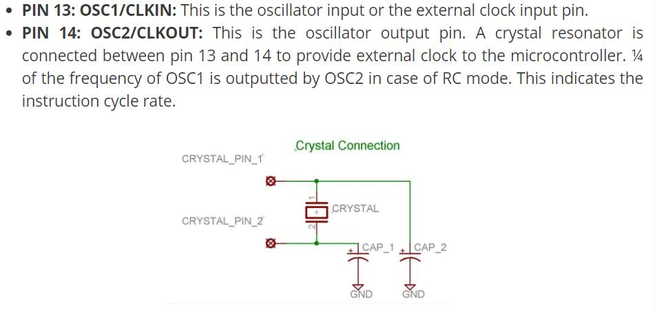
CRYSTAL Oscillator

Slide 18
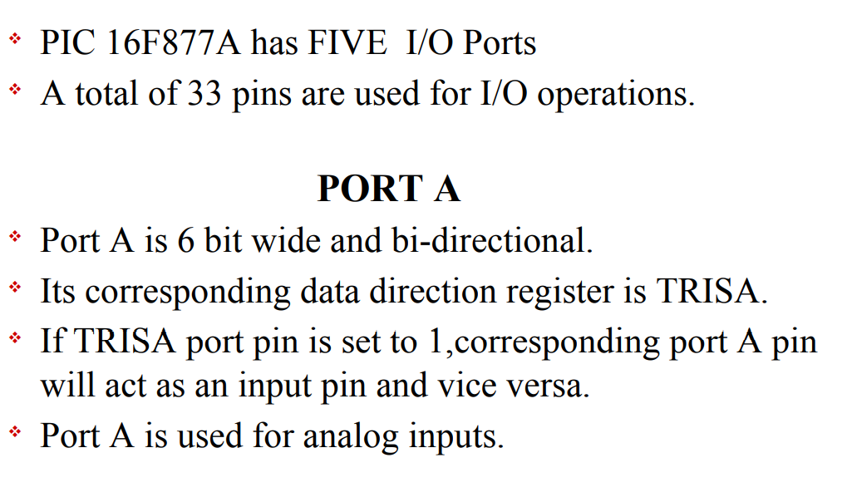
PORT A

Slide 19
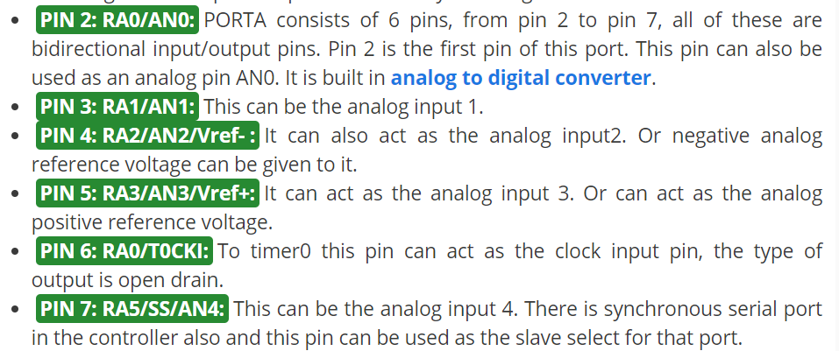
Port A

Slide 20
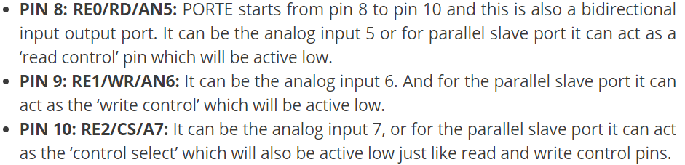
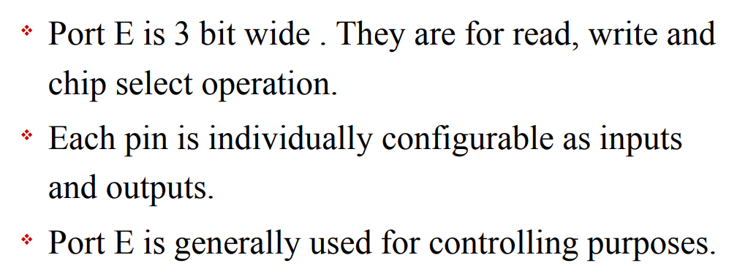
Port E

Slide 21
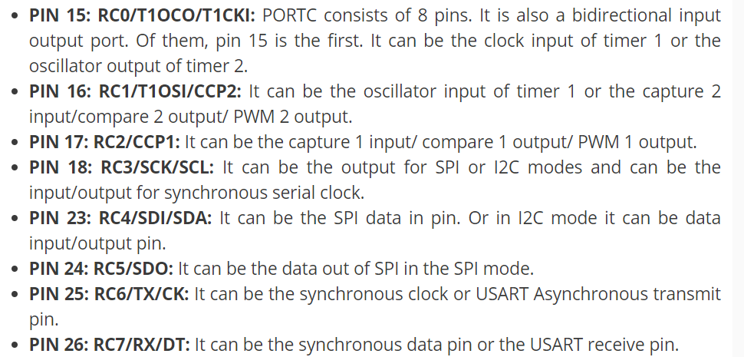
PORT C

Slide 22
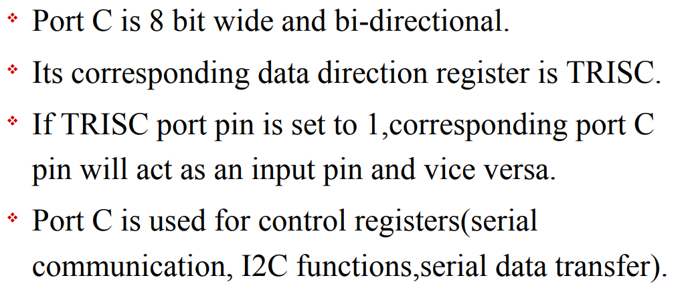
PORT C

Slide 23
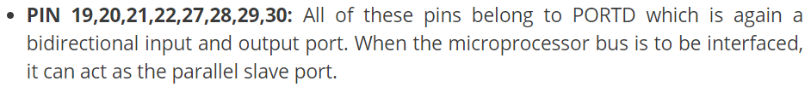
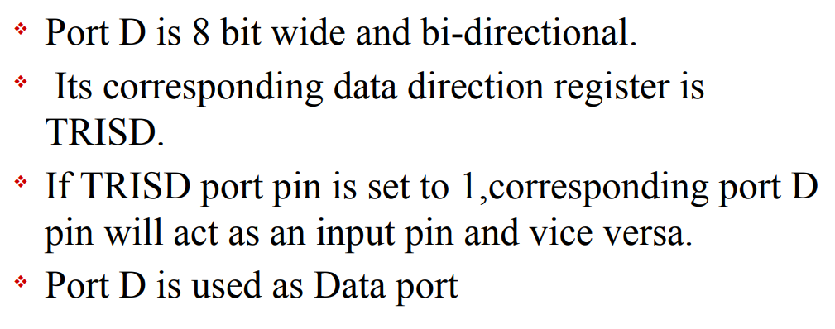
Port D

Slide 24
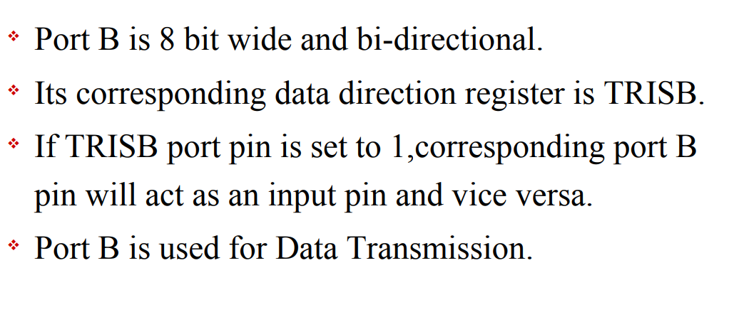
PORT B

Slide 25
Multifunctional PINS
Like PORTC pins can be used as digital input pins, digital output pins, for UART communication, I2C communication. But, we can use one function of each port at a time or you have to program it smartly so that you can switch between different functionalities.
Like once you need one pin to read analog signal, define it for analog purpose and then switch to other functions like digital output etc.
For beginners, we suggest to use one pin for single functionality and you can use multi-function mode, once you become an expert in programming.

Slide 26
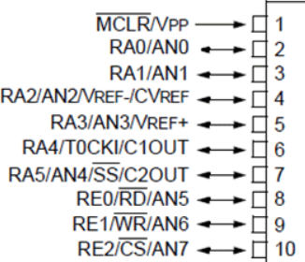
Features of PIC16F877A
Analog to digital converter module : It has 8 bit ADC module which consists of 8 channels. We can use 8 analog sensors with this microcontroller.

Slide 27
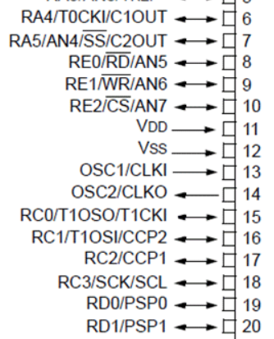
Timers
Timers: It provides three timers timer0, timer1 and timer2.
All these timers can be used either in timer mode or in counter mode. These timers are used to generate delays, pulse width modulation, counting external events and timer interrupts.
TIMER0 is a 8 bit timer and it can operate with internal or external clock frequency. When we use Timer0 in timer mode, we usually operate it with internal frequency and in counter mode, we trigger it with external clock source.
TIMER1 is a 16-bit timer and it can also operate in both modes.
TIMER2 is also of 8-bit. It is used with PWM as a time base for CCP module.

Slide 28
EEPROM
EEPROM : It also has built-in Electrically erasable read only memory 256 x 8 bytes which can used to store data permanently even if the microcontroller is switched off, data will remain there.

Slide 29
PWM
PWM modules : It also provide 2 CCP modules. CCP stands for capture compare PWM modules. We can easily generate two PWM signals with this microcontroller. The maximum resolution it supports is 10 bits.

Slide 30
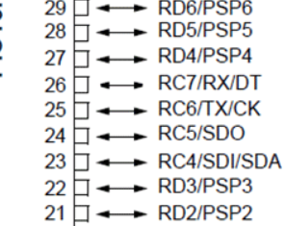
UART
Serial or UART communication pins : It support one UART channel. UART pins are used for serial communication between digital devices.
RC7 pin is a transmitter or RX pin which is pin number 26.
RC6 is a receiver or Tx pin which is pin number 25

Slide 31
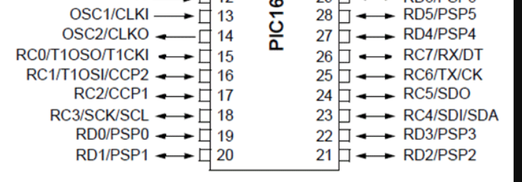
I2C Communication
PIC16F877A also support I2C communication and its has one module for I2C communication.
Pin#18/RC3 and 23/RC4 are SCL and SDA pins respectively.
SCL is a serial clock line and SDA is serial data line.

Slide 32
Interrupts
PIC16F877A microcontroller provides 15 types of interrupts
External
Timer 0
Timer 1
RB Port Change
Parallel Slave Port Read/Write
A/D Converter
USART Receive
USART Transmit
Synchronous Serial Port
CCP1 (Capture, Compare, PWM)
CCP2 (Capture, Compare, PWM)
TMR2 to PR2 Match
Comparator
EEPROM Write Operation
Bus Collision

Slide 33
Comparator
It has a comparator module which composed of two comparators.
They are used for comparison of analog signal similar to comparators in electronics circuits.
Input pins for these comparators are RA0, RA1, RA2 and RA3 and output can measured through RA4 and RA5.

Slide 34
Watchdog timer
WDT is a on chip separate oscillator which runs freely.
It is a separate oscillator from OSC1/CLKI.
WDT will also work even if the device is in sleep mode.
It is used to wake up device from sleep mode and also used to generate watchdog timer reset.

Slide 35
Sleep mode
PIC16F877A also provide sleep mode operation.
In this mode, device operates at very low power.
All peripherals draws minimum amount of current. Wake up from sleep mode from interrupts resources like timer1 interrupt, uart interrupt, EEPROM write completion operation and many others.

Slide 36
Brown out detection
It also has a brown out detection circuit which detects the significant drop in power supply voltage. If supply voltage drop from a certain limit, it will generate a interrupt signals.
This configuration bit (BODEN) is used to disable or enable this circuitry.

Slide 37
Brown out reset
This option reset the device upon detection of brown out interrupt signal from BODEN signal. if supply voltage goes below threshold for more than 100 micro seconds,Programmable code protection,
Brown out reset will occur and device will remain reset until the voltage raise to its nominal value. Device checks for voltage after every 72ms.

Slide 38
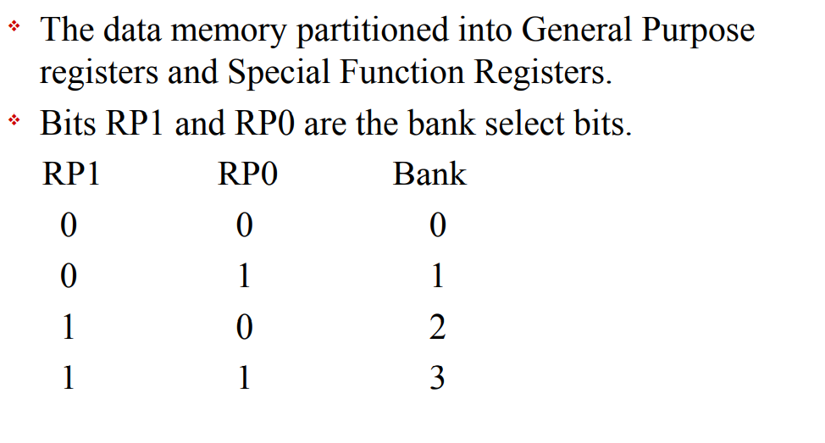
Data Memory Organization

Slide 39
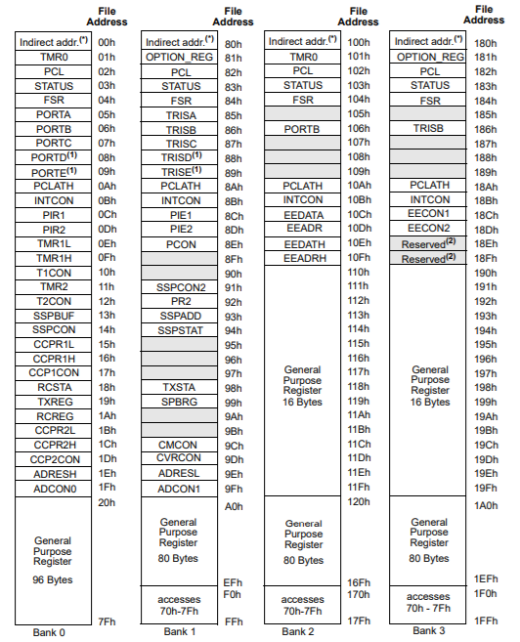
Register

Slide 40
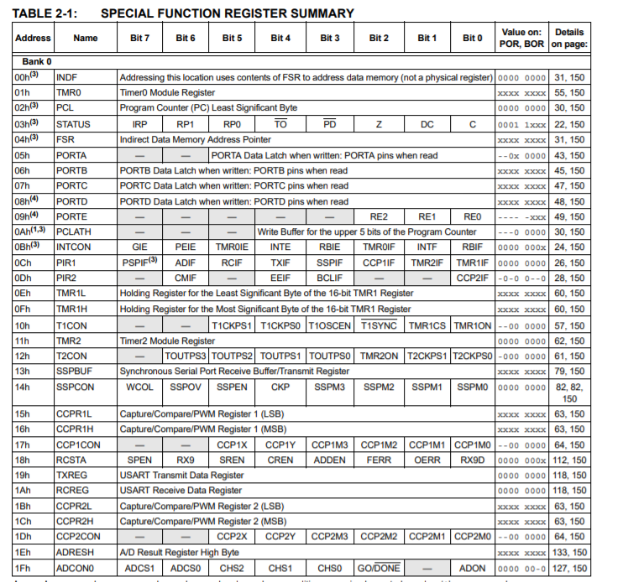
Special Function Registers

Slide 41
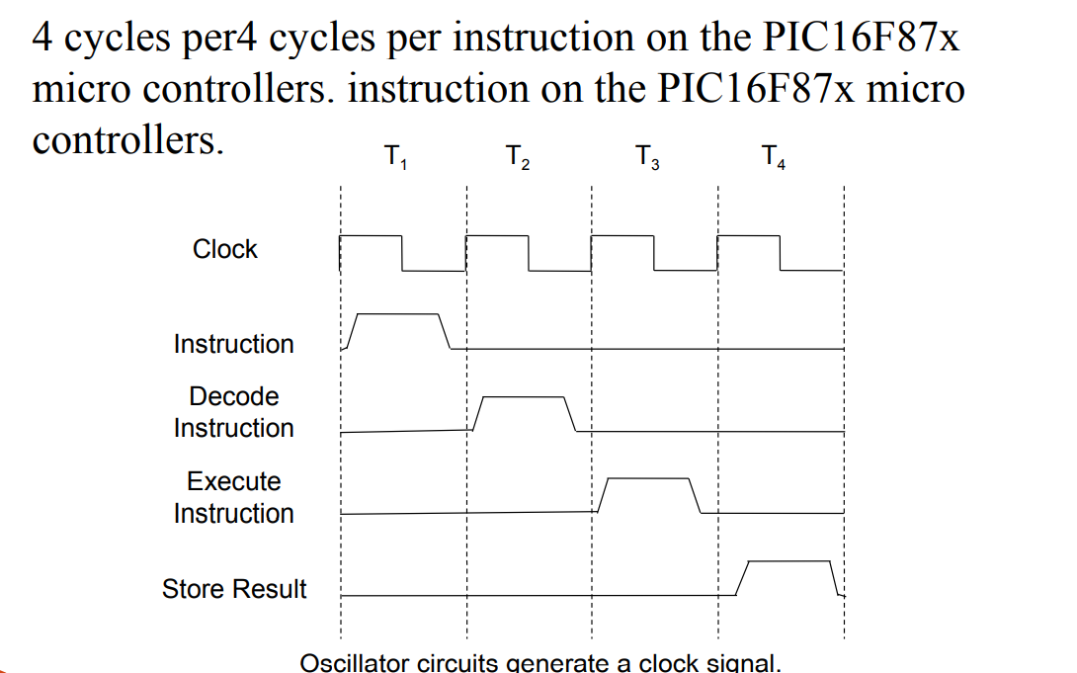
MACHINE CYCLE

Slide 42
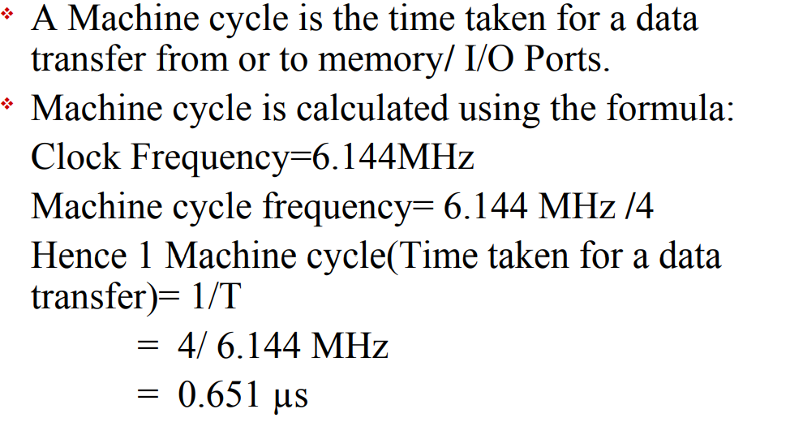
MACHINE CYCLE CALCULATIONS

Slide 43
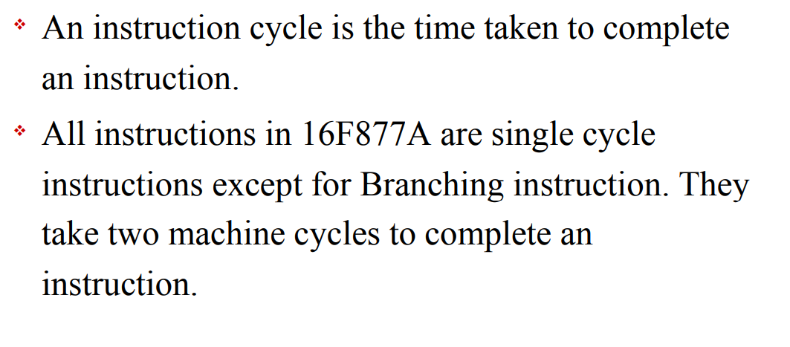
Instruction Cycle

Slide 44
Different Types of Top PIC Microcontroller Compilers
MPLAB XC8 C Compiler
MPLAB XC16 C Compiler
MPLAB XC32 C Compiler
Mikro C Compiler
PIC CSS Compiler

Slide 45
Thank You

